Slide 1
第六节：LangChain考古
2024.8.20

Slide 2
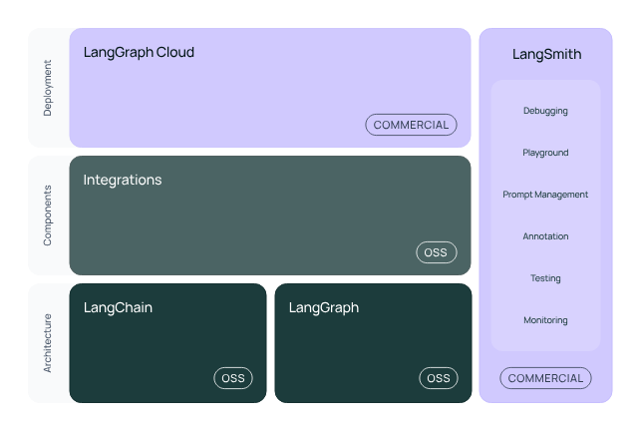
Introduction
https://python.langchain.com/v0.2/docs/introduction/

Slide 3
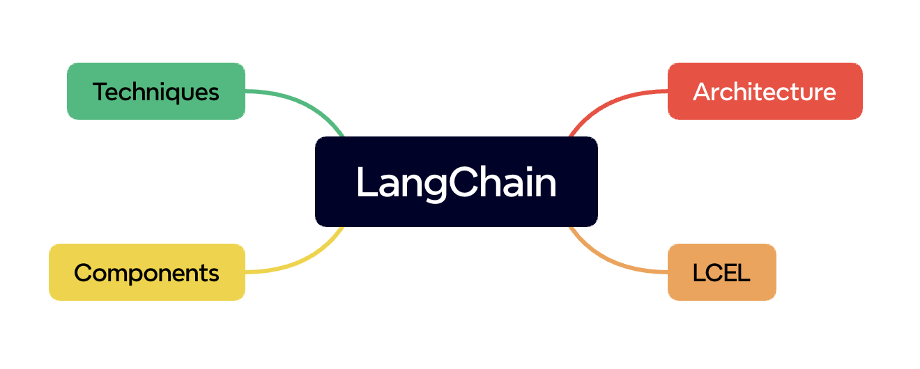
Conceptions
https://python.langchain.com/v0.2/docs/concepts/

Slide 4
Tutorials & Integrations
Tutorials
https://python.langchain.com/v0.2/docs/tutorials/
Integrations
https://python.langchain.com/v0.2/docs/integrations/platforms/

Slide 5
THANK YOU

